Slide 2
Nanofibers as Advanced Waterless Delivery Systems
Laura M. Frazier, PhD
Chief Scientist
TaikiUSA

Slide 3
WHAT ARE NANOFIBERS?
Fibers with a diameter of < 1 micron
Electrospinning is most common method
Variety of polymers can be used

Slide 4
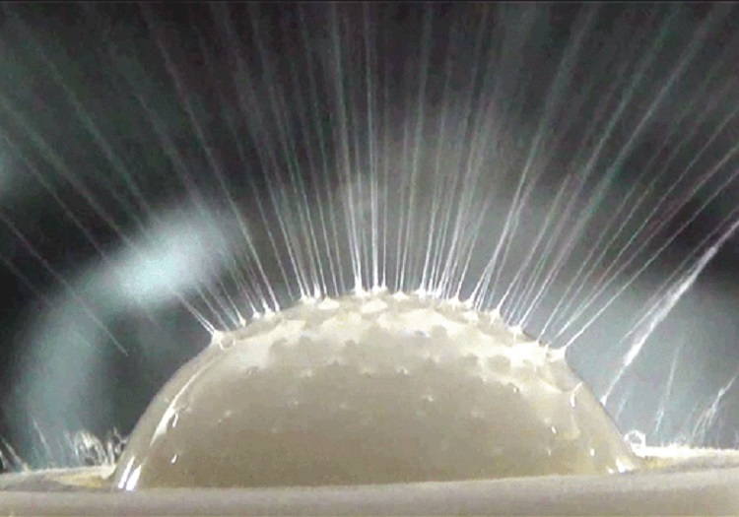
NANOFIBER PRODUCTION
Using a patented ball electrospinning process, nanofibers are produced as a dry nonwoven sheet.

Slide 5
Pullulan and Sodium Hyaluronate are used to form the nanofiber structure of our nanofibers.
Both are polysaccharides and water soluble.

Slide 6
NANOFIBER SHEETS
Dry powders- water soluble
Non-water-soluble particles
Liquids- aqueous
Oils

Slide 7
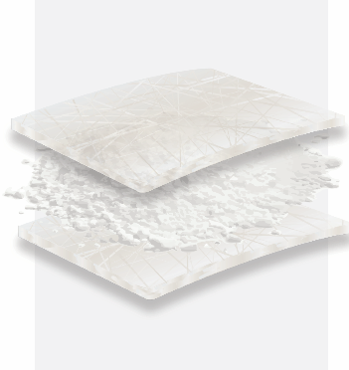
LAYERED SYSTEMS
Each layer can contain a different active
Allows actives to remain isolated from one another until applied
Hard to disperse powders can also be placed in between electrospun fiber layers

Slide 8
Waterless Products made from Electrospun Polymers
Notes:
Align the “actives”

Slide 9
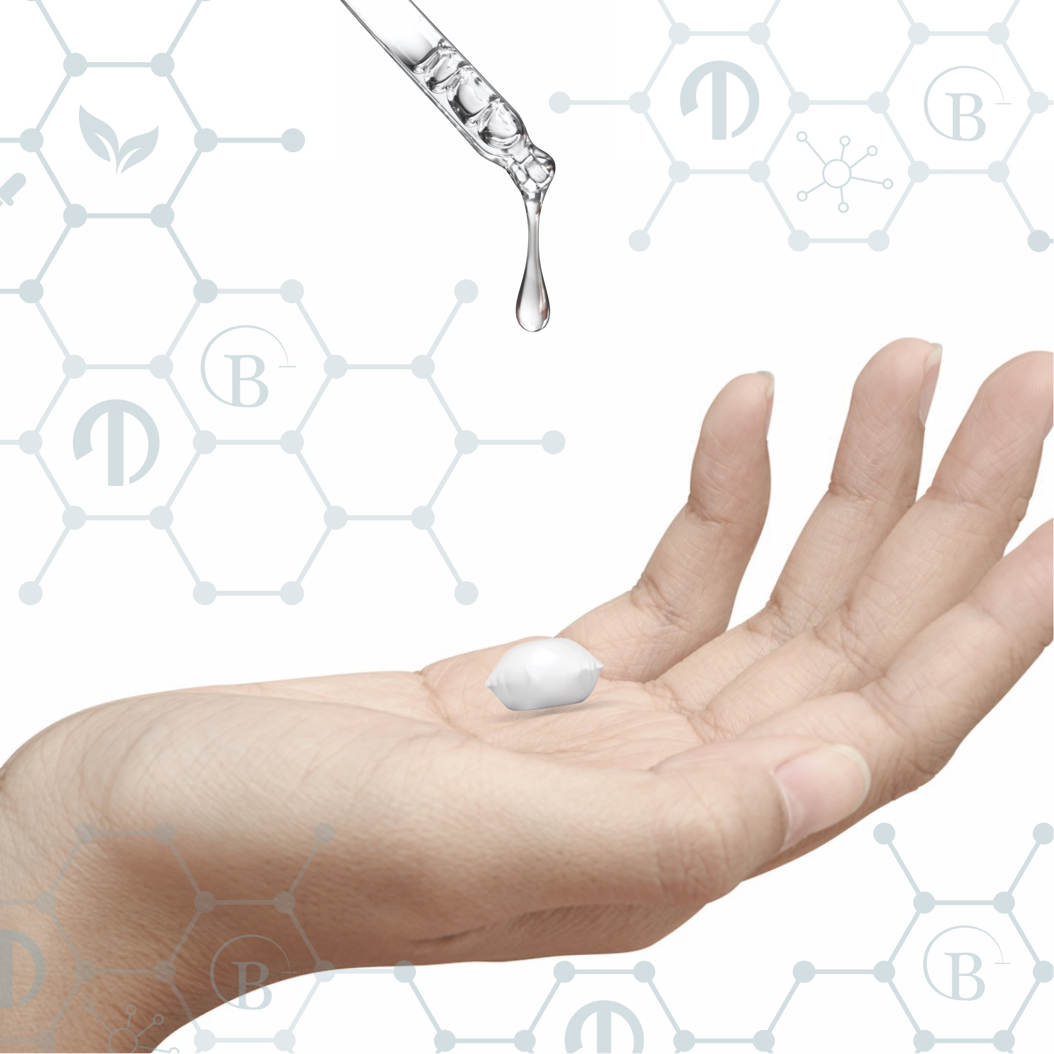
BŌSHI BENEFITS
Increased penetration
Low water activity
Elimination of ingredients
Convenient to use
Multifunctional
Optimal dosage
Improved stability

Slide 10
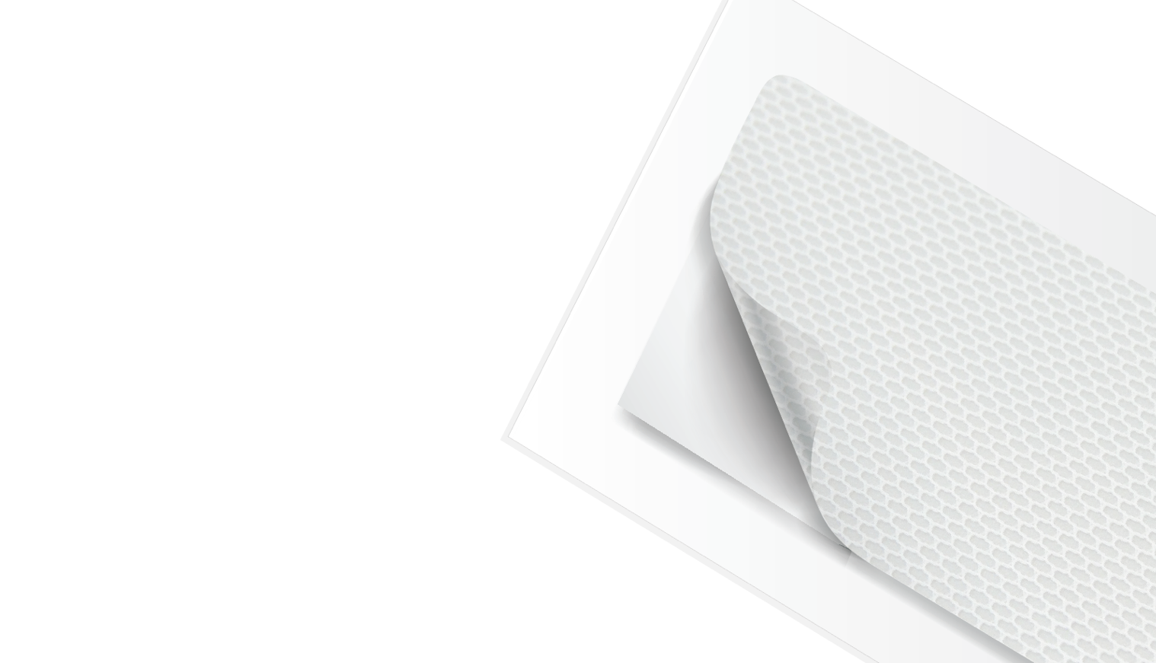
NANO STRIPS
Nanostrips can be cut into various shapes, such as under eye patch, T-zone, or a full facemask.
Intended as a targeted treatment, nanostrips will deliver the perfect dose right where you want it.

Slide 11
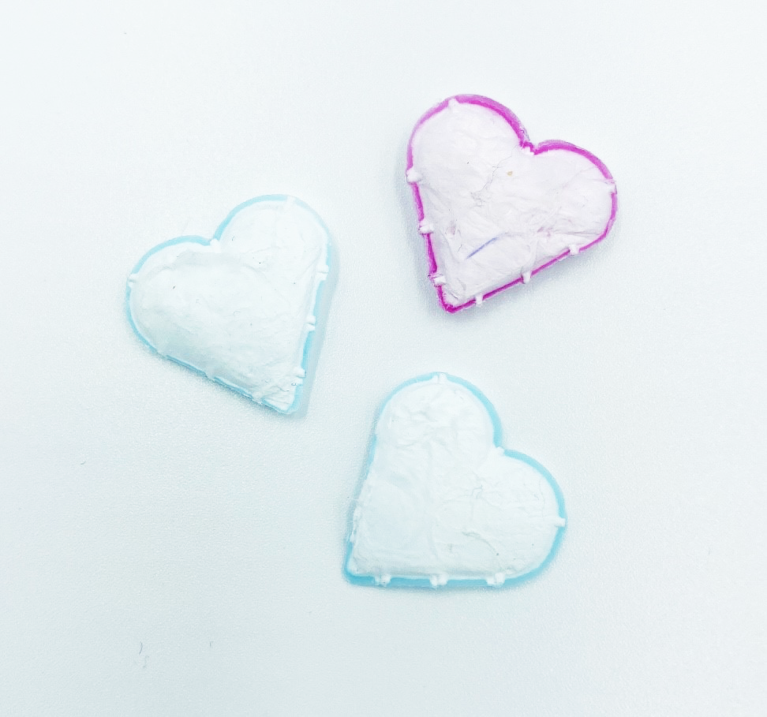
NANO DROPS
Intended as a full-face application, nanodrops are dissolved just prior to use.
Just place in the palm of your hand and dissolve with water or a toner.

Slide 12
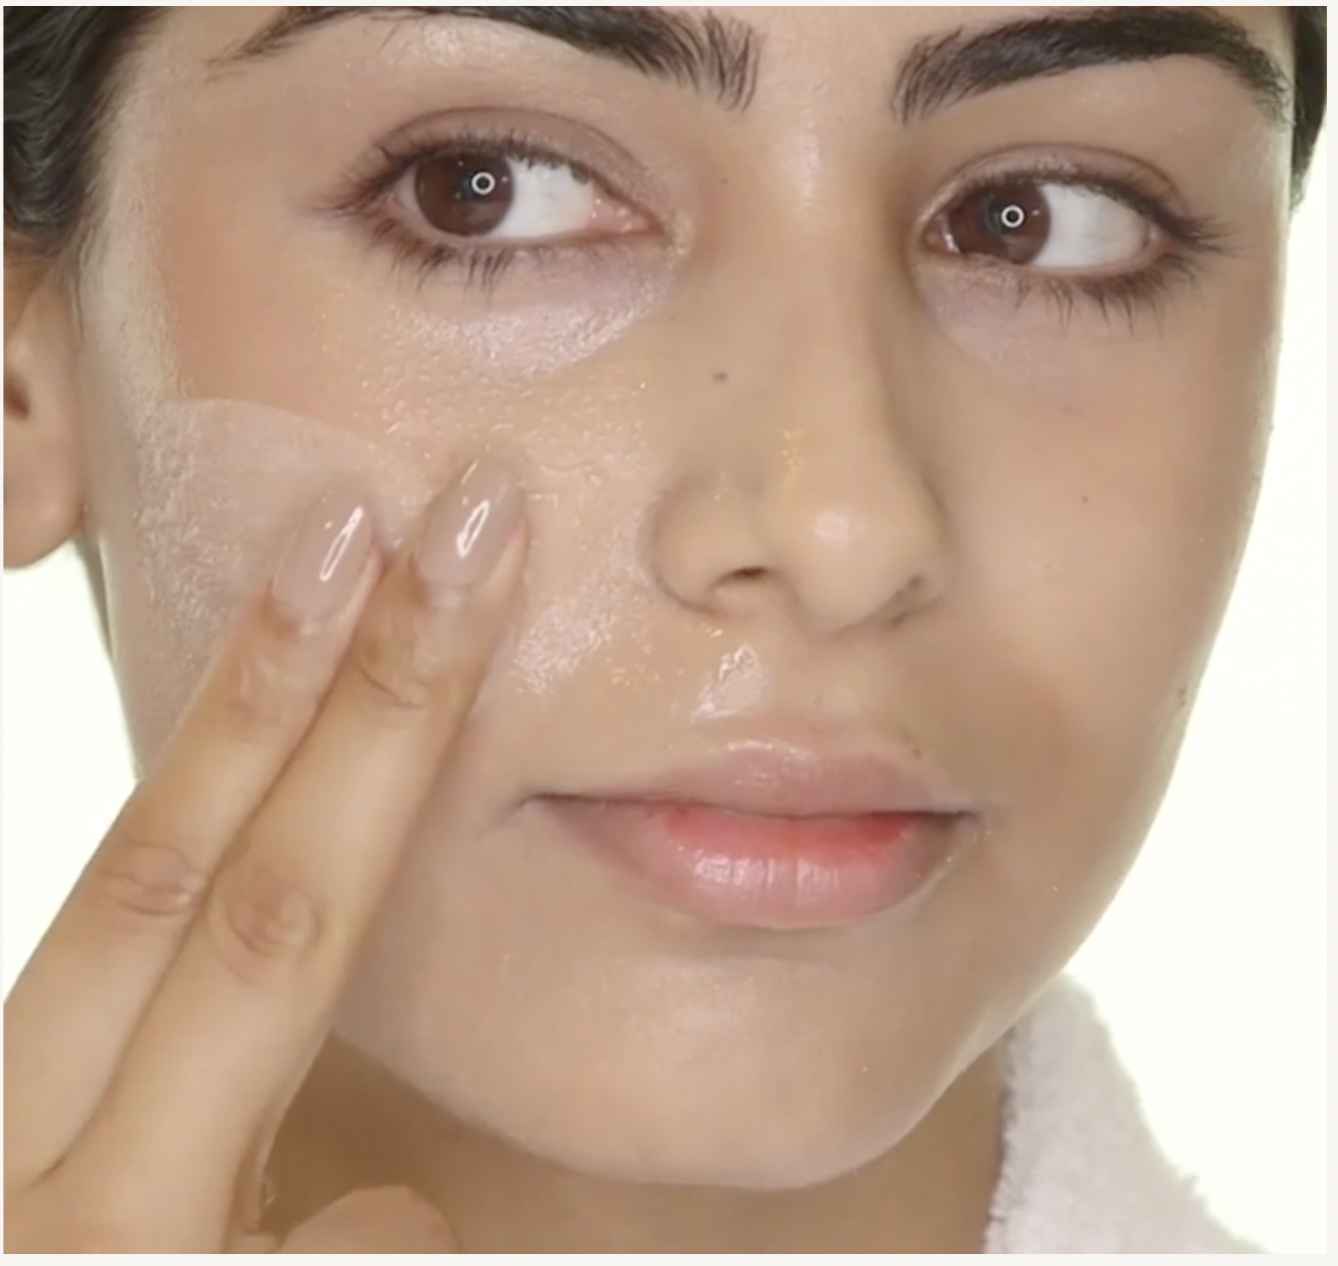
SKINCARE
Blemish
Soothing
Anti-aging
Hyperpigmentation
Cleansing
Brightening
Moisturizing
Hydrating

Slide 13
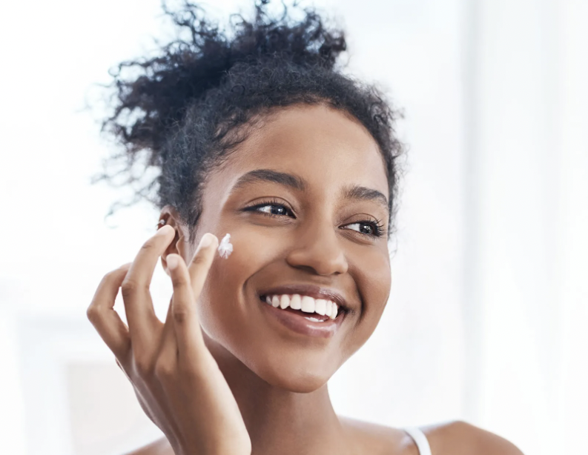
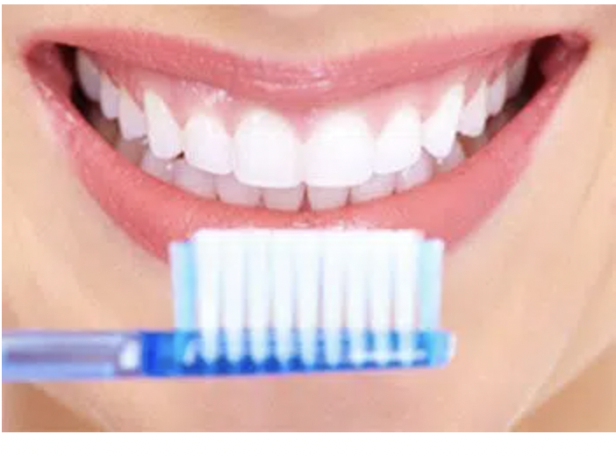
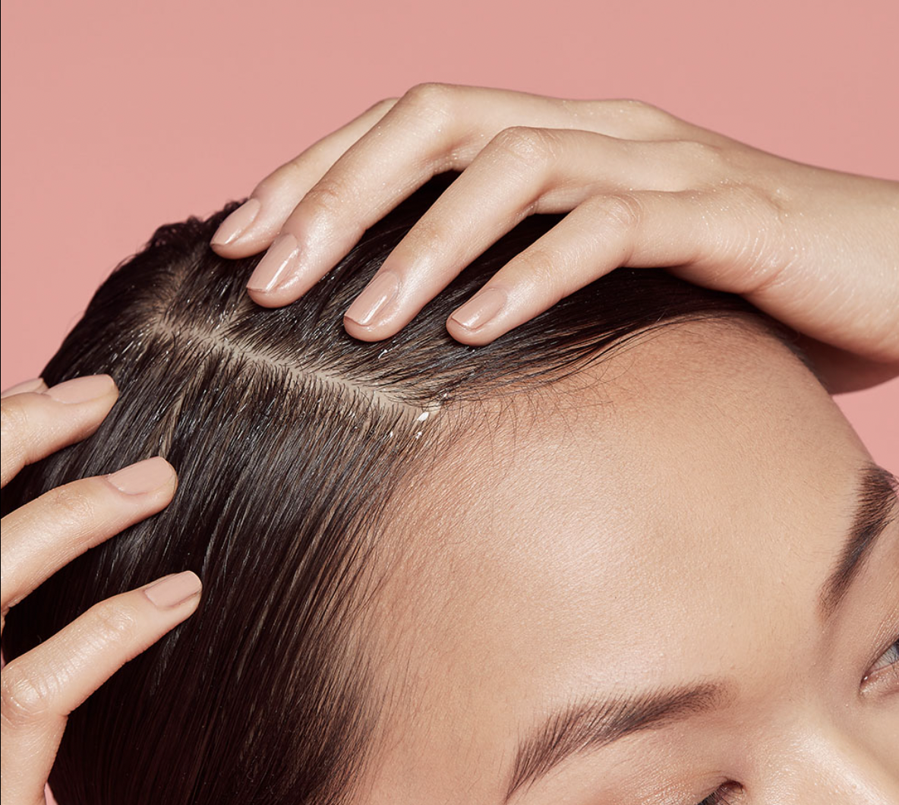
BEYOND SKINCARE
Oral Care
Sun Care
Scalp Care
Fragrance
Hair Care
Nail Care
Home Care
Pet Care
Outdoor Care

Slide 14
EXTREMELY VERSATILE BŌSHI CAN BE:
More sustainable
Natural
“Clean”
Waterless
Biotech-derived
Travel friendly
Customizable
Simple
Multifunctional

Slide 15
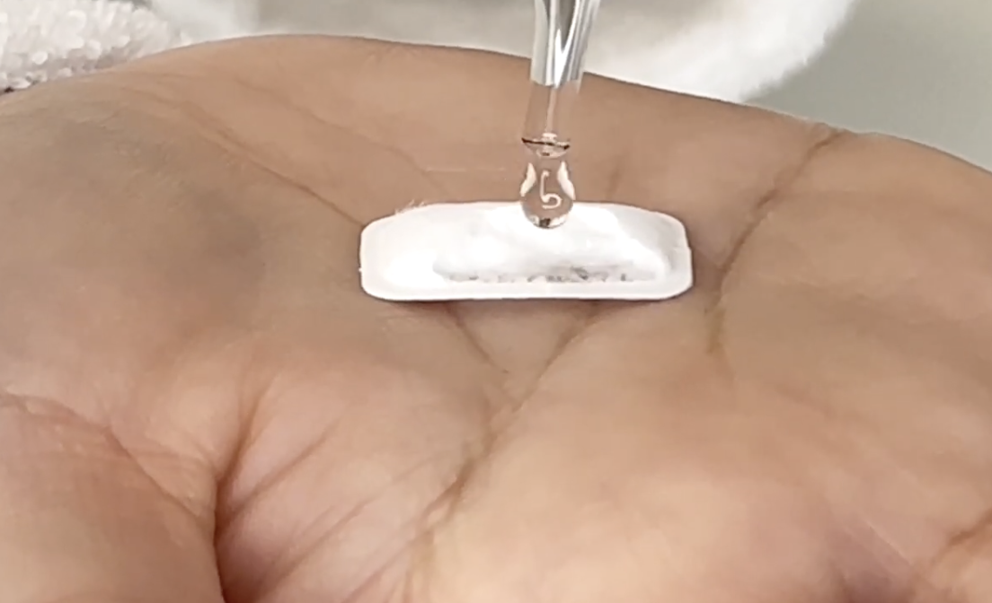
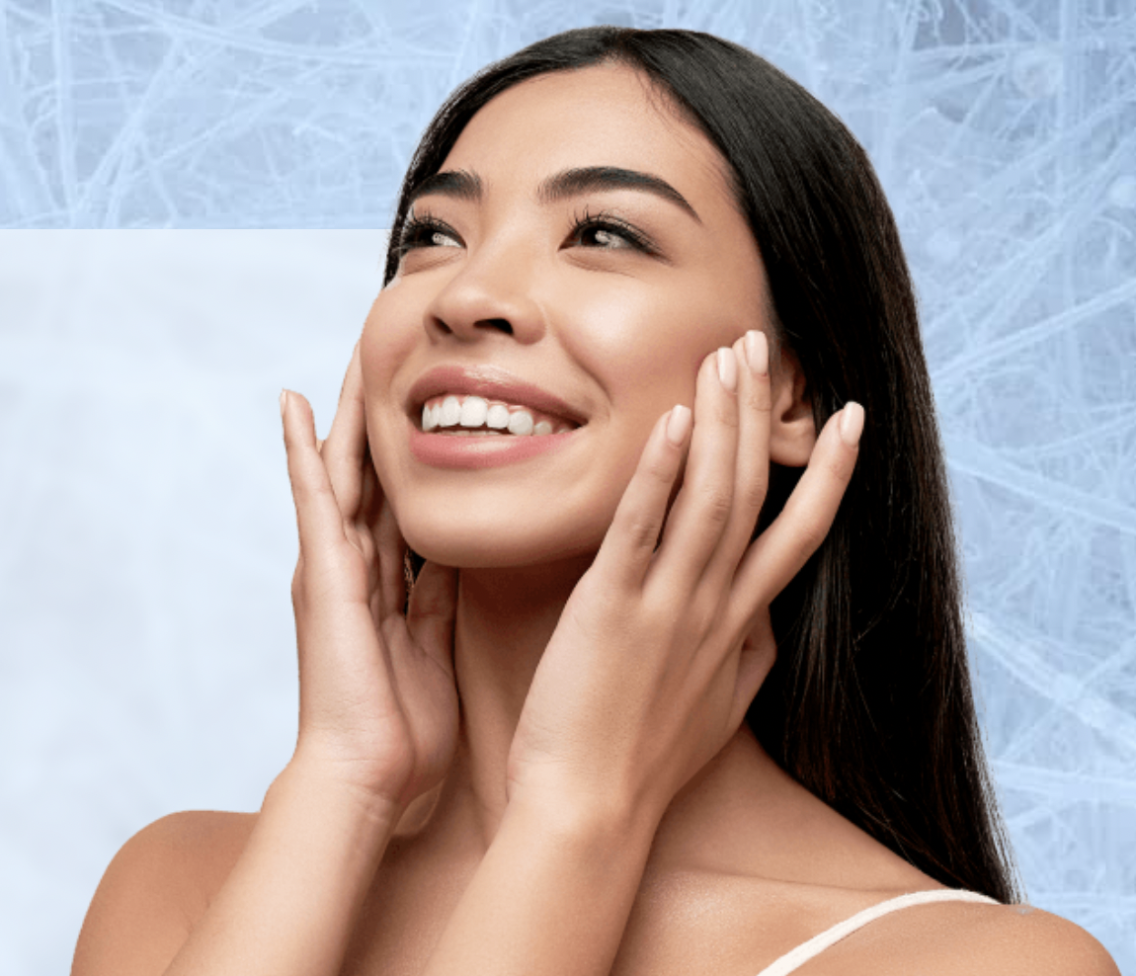
Customer Survey Results: Water-activated Nanodrop Serums vs Traditional “dropper bottle” Liquid Serums.
The single nanodrop dissolved easily every day with 4-6x sprays of the spritz
97% Agree
98% Agree
Overall nanodrop experience was positive
Given my experience on the efficacy of the nanodrop, I prefer using the nanodrop serum above liquid serum
81% Agree
100% Agree
I found it reassuring to know that a single nanodrop always contains the perfect amount of serum required to cover my face
Notes:
100 people surveyed
2 different formulas
Over 30 days

Slide 16
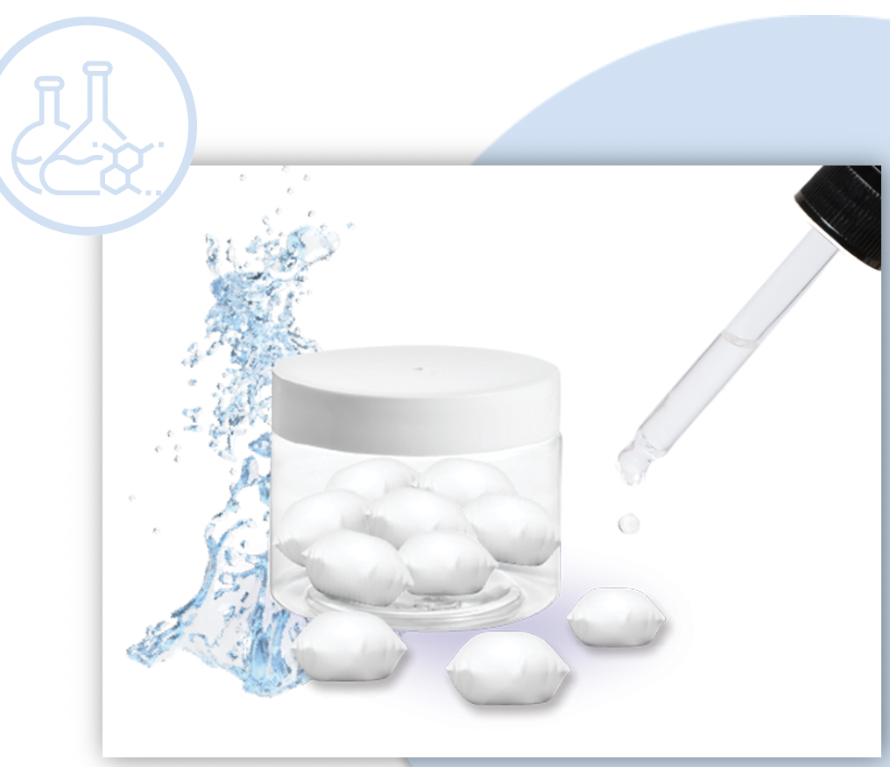
ADVANCED CARE
Precise dose
New formulation options
Adaptable
Effective
Personalized

Slide 17
MORE TO COME….
LCA analysis of process
Stability of ingredients in various Bōshi fiber formats
Activity of ingredients in Bōshi compared to traditional formulations

Slide 18
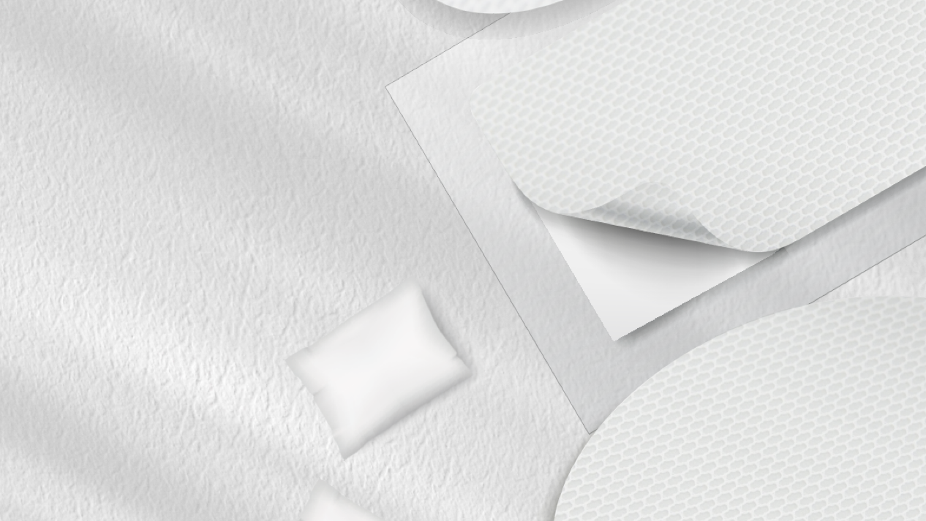
ACKNOWLEDGEMENTS
Many thanks to the team at TaikiUSA and SNC for their assistance in putting together this presentation.
Thank you all for your kind attention!
lfrazier@taikiusa.net
www.taikibeauty.com

